Slide 1
HEALTH MENTAL ILLNESS PROJECT
Caleb Brewer

Slide 2
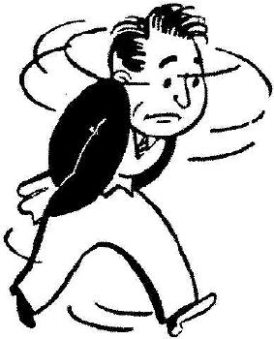
Name of illness: Anxiety.
The illness that I researched is Anxiety.
Definition of anxiety is “a feeling of worry, nervousness, or unease, typically about an imminent event or something with an uncertain out come”

Slide 3
Risk factors of anxiety
The risk factors of anxiety are
-Family history of panic attacks or panic disorder
-Major life stress, such as the death or serious illness of a loved one
-A traumatic event, such as sexual assault or a serious accident
-Major changes in your life, such as a divorce or the addition of a baby
-Smoking or excessive caffeine intake
-History of childhood physical or sexual abuse

Slide 4
Prevention of anxiety
Preventions of anxiety are
Quitting smoking
Quitting drinking
Stop drinking too much caffeine

Slide 5
Symptoms of anxiety
Symptoms of anxiety are
-Reduced interest and/or pleasure in activities most of the day, almost every day.
-Significant weight loss or gain not related to dieting
-Increased or decreased appetite
-Major changes in sleeping patterns
-Fatigue or loss of energy almost every day.
-Feeling worthless or having excessive guilt almost every day.
-Problems with concentration almost every day.
-Recurring thoughts of death (more than fear of dying), suicidal ideation, a suicide attempt, or a specific plan for committing suicide

Slide 6
How to treat anxiety
Way to treat anxiety is
Psychotherapy, including cognitive behavioral therapy
Medications, including antianxiety medications and antidepressants
Complementary health approaches, including stress and relaxation techniques

Slide 7
How help your friend with anxiety.
To help your friend, these are things that you can do
Learn about the disorder.
Encourage treatment.
Realize and accept stressful periods.
Remember that everyone experiences anxiety differently.
Be encouraging and don't get discouraged.
Ask how you can help.
Talk to someone

Slide 8
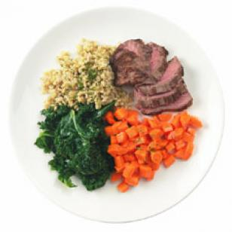
How to help yourself from anxiety.
If you have anxiety, these can be help
Take a time-out. ...
Eat well-balanced meals. ...
Limit alcohol and caffeine, which can aggravate anxiety and trigger panic attacks.
Get enough sleep. ...
Exercise daily to help you feel good and maintain your health. ...
Take deep breaths

Slide 9
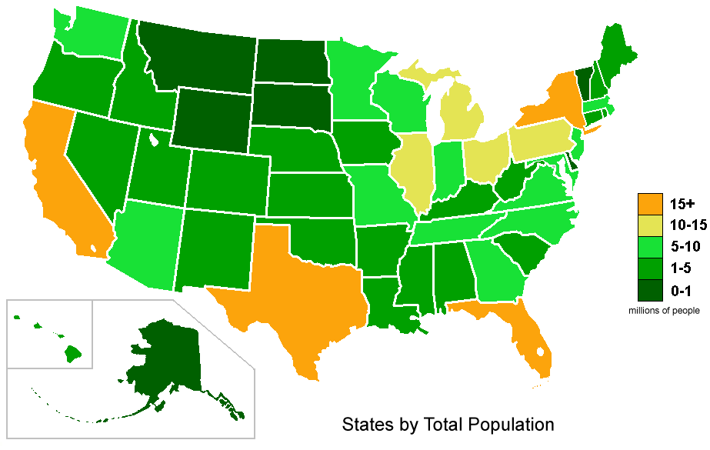
5 statistic of anxiety
1. affect 18.1 percent of adults in the United States (approximately 40 million adults between the ages of 18 to 54)
2. approximately 30 percent of people doesn’t request help
3. More than $22.84 billion of those costs are associated with the repeated use of healthcare services
4. anxiety disorders cost the U.S. more than $42 billion a year
5. 41 percent of employees from a range of industries reported high levels of anxiety

Slide 10
Role of social media
It is SUGGESTED that you don’t use social media. There is possibilities of creating more serious anxiety (loneliness, depression)
You can still use it with your own risk

Slide 11
Important, or interesting facts.
1. Women have double the risk for anxiety disorders than men do
2. Anxiety disorders are the most common mental illness in the United States
3. Anxiety disorders are often accompanied by other related disorders
4. Anxiety can cause or exacerbate physical illnesses
5. Anxiety may be hereditary (means that your children might get it.)

